Slide 1
Advanced OOP2
Do Quoc Binh

Slide 2
Static typing
Static typing is the process of enforcing type safety at compile-time. The compiler prohibits certain operations, based on the type of the objects involved
Most type safety is enforced in C# at compile-time (static typing).

Slide 3
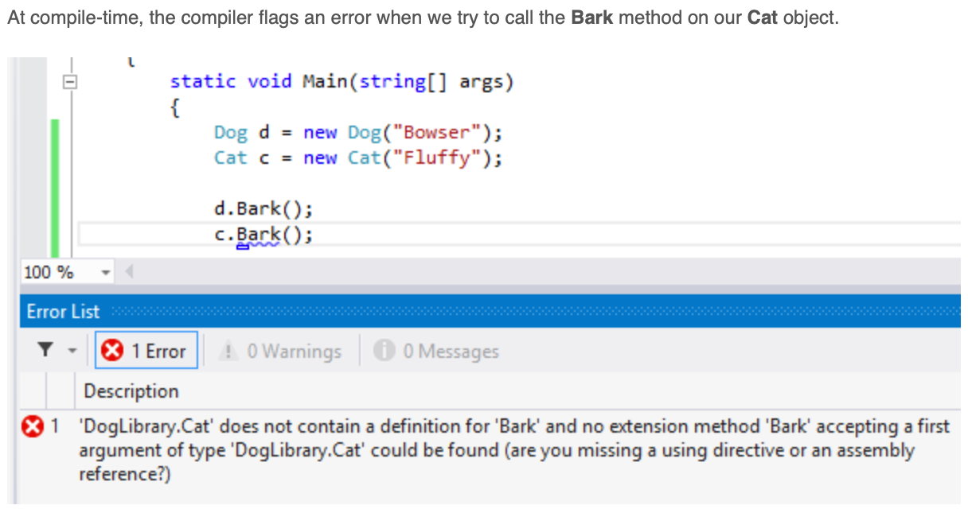
Static type example

Slide 4
Dynamic Type
C# 4.0 (.NET 4.5) introduced a new type that avoids compile time type checking
You have learned about the implicitly typed variable- var in the previous section where the compiler assigns a specific type based on the value of the expression
A dynamic type escapes type checking at compile time; instead, it resolves type at run time.

Slide 5


Example: dynamic type variable
Would compile as

Slide 6
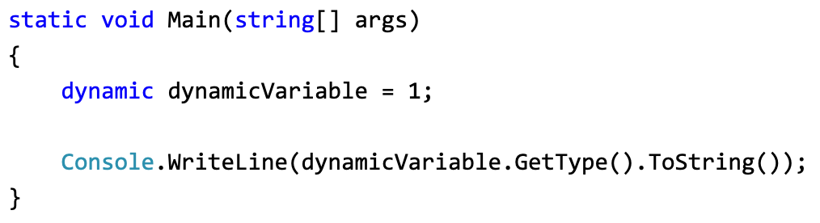
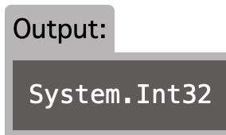
Example: dynamic type variable(2)

Slide 7
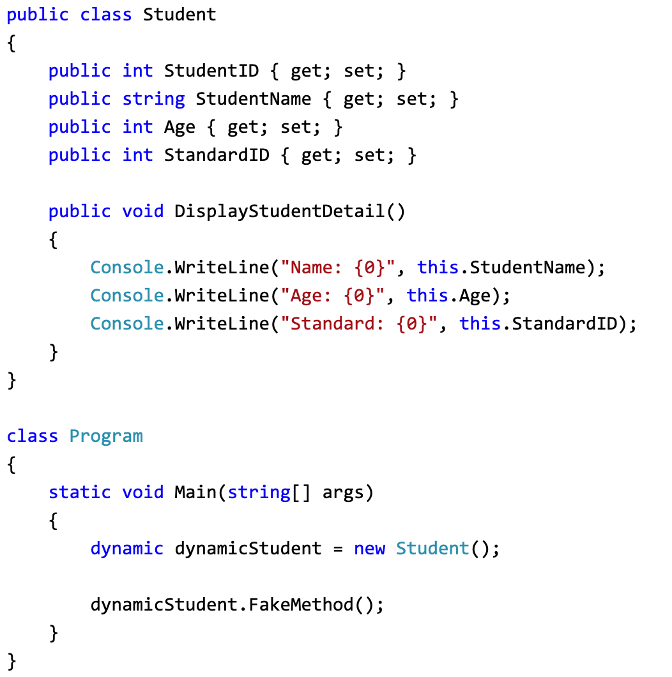
Methods and Properties of Dynamic Type

Slide 8

Explain the code
We call FakeMethod() method, which is not exists in the Student class
However, the compiler will not give any error for FakeMethod() because it skips type checking for dynamic type
Instead you will get a runtime exception for it as shown below.

Slide 9
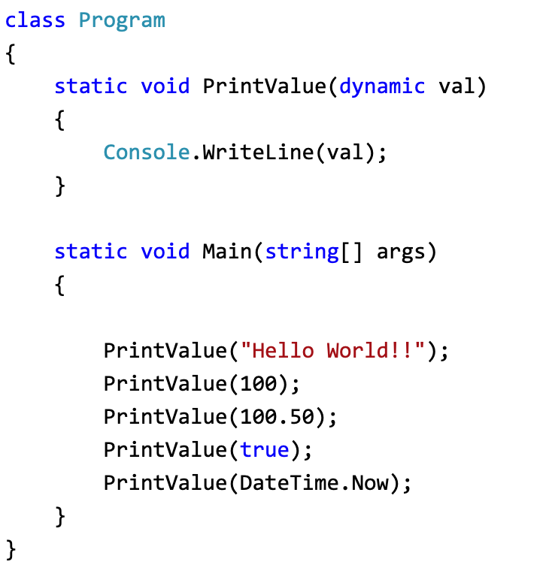
Dynamic Type as a Method Parameter

Slide 10

Output

Slide 11
Discussion in group
Whether good or not when using dynamic typing?

Slide 12
Abstract class
The abstract modifier indicates that the thing being modified has a missing or incomplete implementation
The abstract modifier can be used with classes, methods, properties, indexers, and events
Use the abstract modifier in a class declaration to indicate that a class is intended only to be a base class of other classes

Slide 13
Abstract classes ’s features
An abstract class cannot be instantiated.
An abstract class may contain abstract methods and accessors
It is not possible to modify an abstract class with the sealed modifier because the two modifiers have opposite meanings
A non-abstract class derived from an abstract class must include actual implementations of all inherited abstract methods and accessors

Slide 14
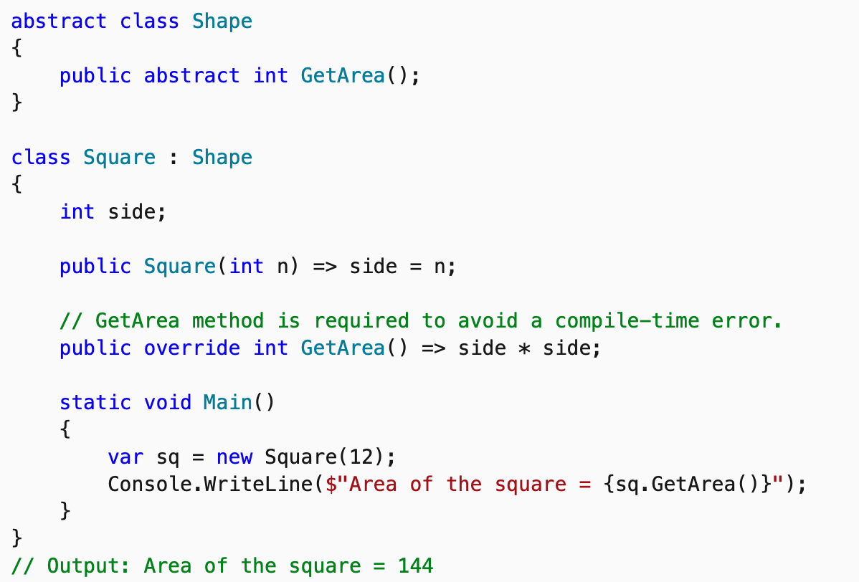
Example

Slide 15
Abstract methods
An abstract method is implicitly a virtual method
Abstract method declarations are only permitted in abstract classes
Because an abstract method declaration provides no actual implementation, there is no method body
It is an error to use the static or virtual modifiers in an abstract method declaration

Slide 16
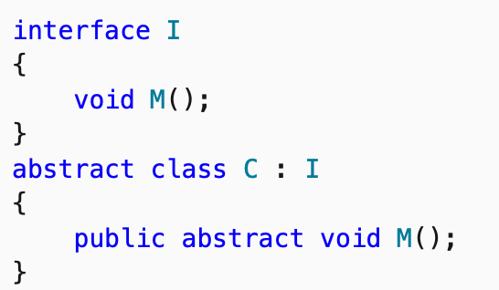
An abstract class that implements an interface

Slide 17
Virtual keyword
The virtual keyword is used to modify a method, property, indexer, or event declaration and allow for it to be overridden in a derived class
By default, methods are non-virtual. You cannot override a non-virtual method.
You cannot use the virtual modifier with the static, abstract, private, or override modifiers.

Slide 18
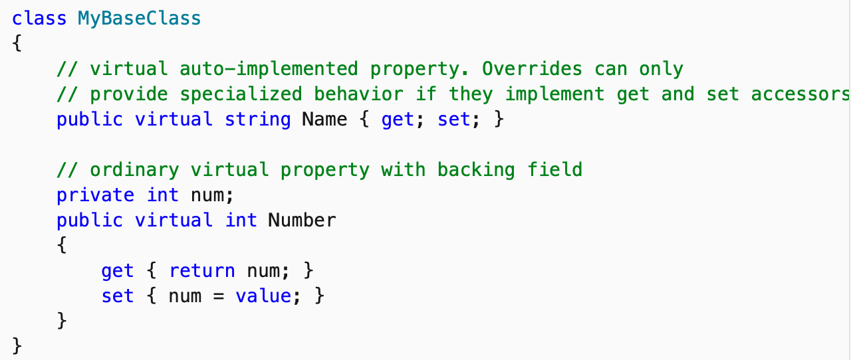
Base class with virtual property

Slide 19
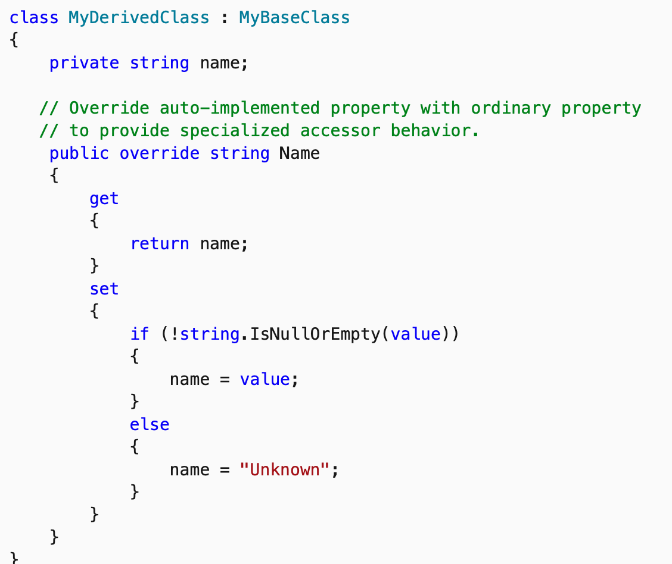
Override virtual method

Slide 20
Multiple inheritance using interfaces
In Multiple inheritance, one class can have more than one superclass and inherit features from all its parent classes
But C# does not support multiple class inheritance
To overcome this problem we use interfaces to achieve multiple class inheritance

Slide 21
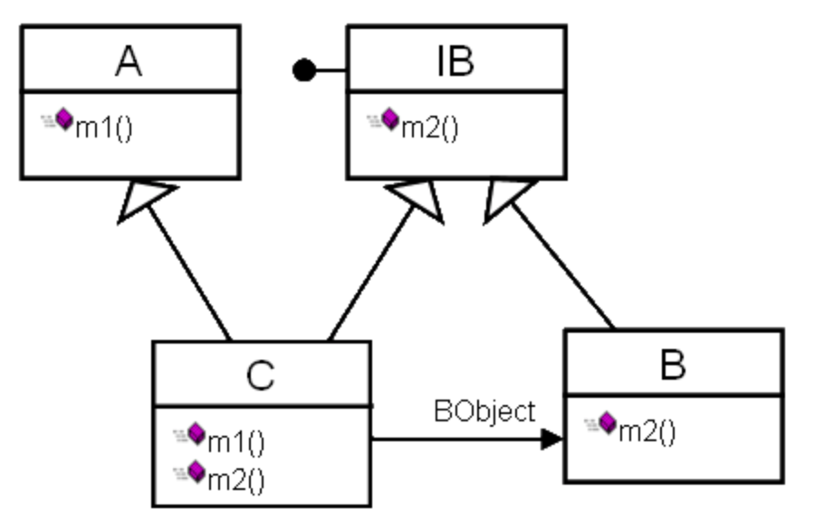
A solution for inheritance from [Code Project]

Slide 22
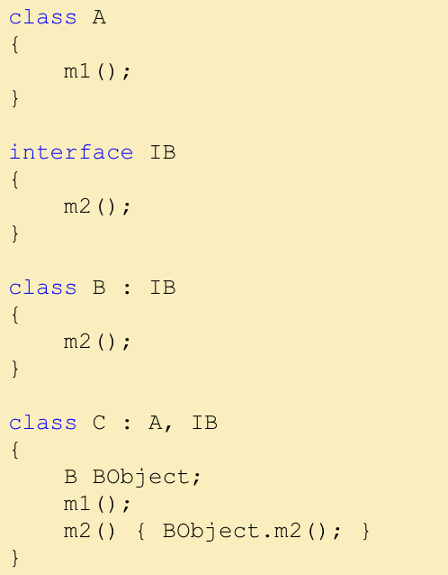
Continue from the previous diagram

Slide 23
References
https://www.tutorialsteacher.com/csharp/csharp-dynamic-type

